Slide 1
Oral malignancy and premalignant lesion
Dr. Bayad J. Mahmood
BDS, FKBMS
Maxillofacial surgeon

Slide 2
Premalignant conditions
Premalignant conditions are a group of disorders associated with an increase in risk of developing oral carcinoma.
These conditions cause epithelial atrophy, which make it susceptible to carcinogens.
Atrophic epithelium has altered cell turn turnover rates and this is likely increase risk factors for developing oral cancer.
These conditions include:
Submucous fibrosis
Sideropenic dysphagia
Atrophic lichen planus
Chronic candidiasis

Slide 3
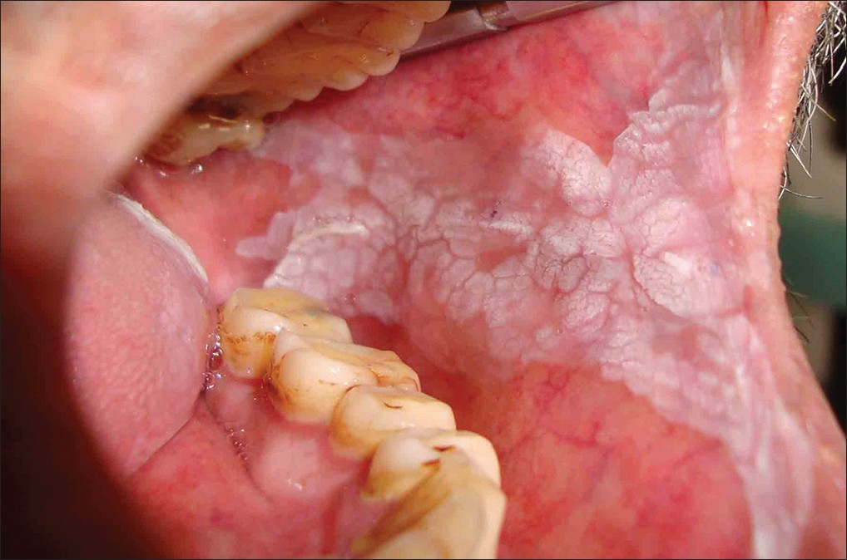
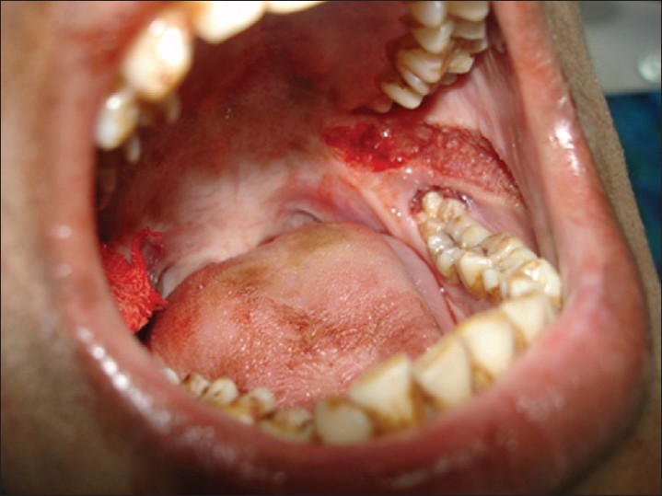
Submucous fibrosis
Oral submucous fibrosis is related to using paan, which is a leaf quid containing areca nut usually in Indian and Southeast Asia.
The leaf is held in the mouth for long periods so a fibrous bands may develop in the buccal mucosa and palate.
Mouth opening becomes restricted and swallowing may be difficult.
The risk of developing oral carcinoma has been estimated at around 5%.

Slide 4
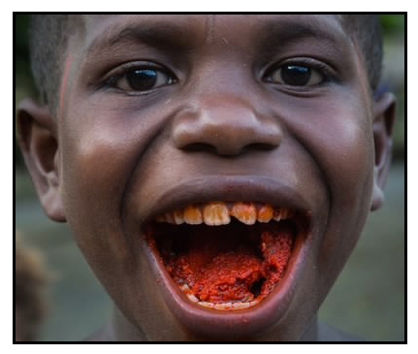

Slide 5
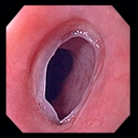
Sideropenic dysphagia
A number of conditions can result in difficulty in swallowing associated with primary iron-deficiency anaemia .
Chronic iron deficiency results in generalized mucosal atrophy as iron is an essential growth requirement for the oral epithelium.
Difficulty in swallowing is due to formation of a post cricoid fold (oesophageal web) which is known as the Patterson-Kelly-Brown or Plummer-Vinson syndrome.
Carcinoma may develop in the oesophagus and less commonly in the oral cavity.

Slide 7
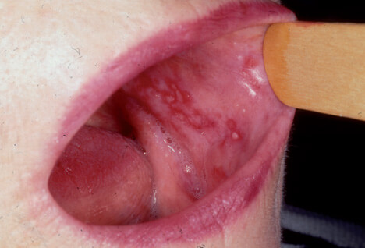
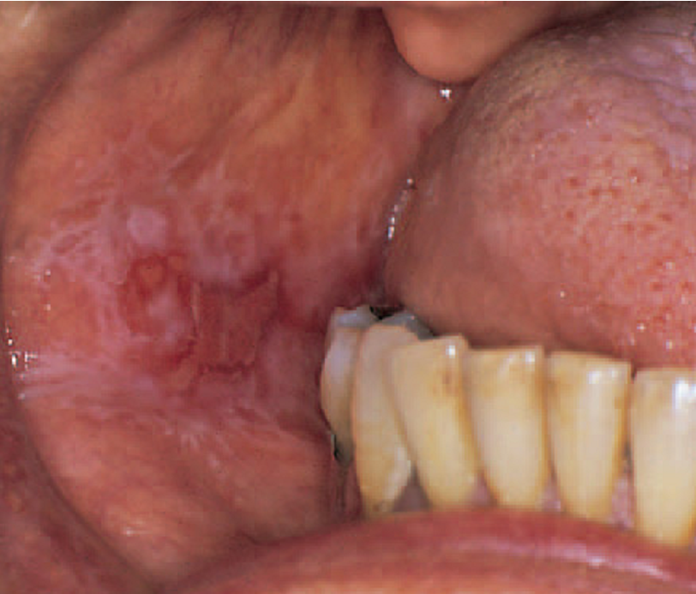
Atrophic lichen planus
Oral lichen planus, characterized by red areas of mucosal thinning and erosions atrophic areas are red areas of mucosal thinning and often combined with striae.
The diagnosis of lichen planus can usually be made on the history, the appearance of the lesions and their distribution.
The risk of and possible frequency of malignant change in lichen planus has been reported to be 1–4% of after 10 years.
Management: Topical application of potent anti-infl ammatory corticosteroids (Triamcinolone), if not effective systemic steroids or Surgical excision will be planned.

Slide 8
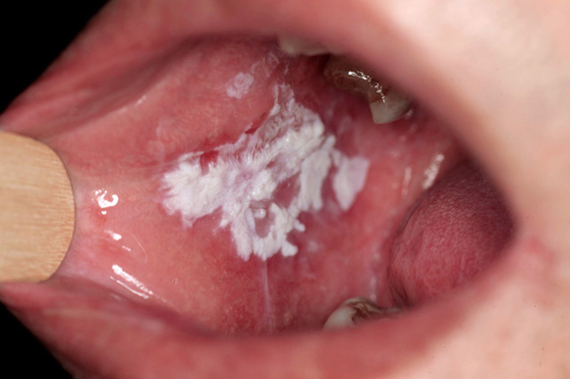
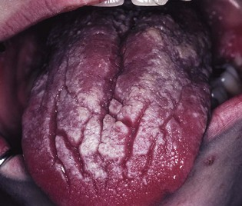
Chronic candidiasis
The presentation of Candida may include symptoms of burning, sensitivity, altered taste, and altered smell. If it involves the pharynx or esophagus, dysphagia may be present.
Many factors may cause candidiasis including:
Local factors: xerostomia, chronic topical steroids, dentures, and smoking.
Systemic factors: antibiotics, systemic steroids, diabetes, hormonal changes, anaemia, and immune diseases.

Slide 9
Premalignant lesions
Premalignant lesions of the oral mucosa are areas of morphologically altered tissue in which cancer can arise. Like the following:
Leukoplakia
Erythroplakia
Erosive lichen planus

Slide 10
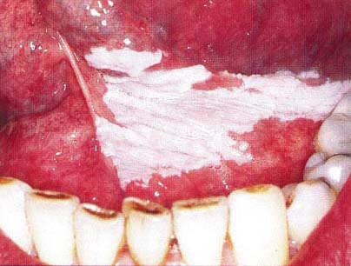
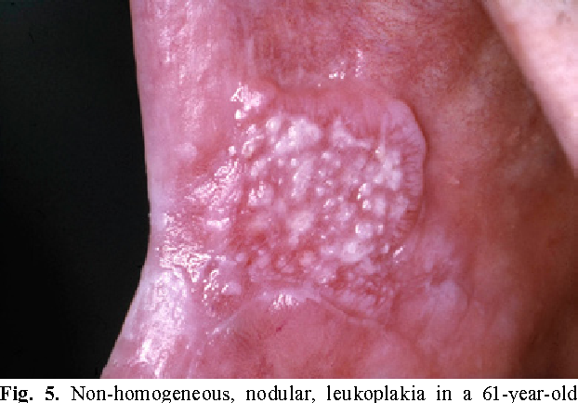
Leukoplakia
Leukoplakia is plaque-like lesions affect the oral mucosa.
The prevalence of leukoplakia varies from 0.2 to 4% and the risk factors are tobacco, alcohol and possibly candidal infection.
Leukoplakia can be classified into:
1. Homogeneous leukoplakias
are plaque-like lesions with a uniform smooth or wrinkled surface; there is less risk of malignant transformation. 2. Non-homogeneous leukoplakias
tend to be less circumscribed and show a greater range of appearances. Verrucous leukoplakia has a warty appearance and speckled leukoplakia has interspersed red areas.

Slide 11
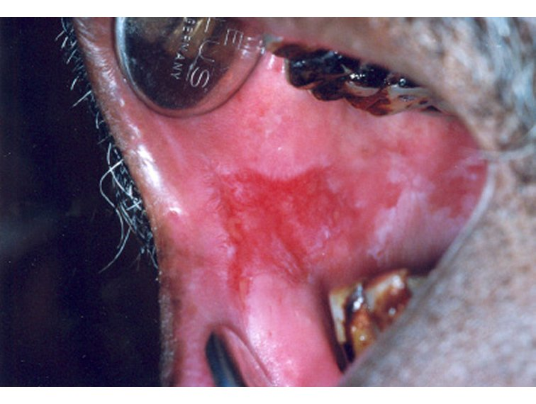
Erythroplakia
Erythroplakia has been defined as a bright-red change on the oral mucosa that cannot be characterized as any other definable lesion.
There is a high risk of malignant transformation in these lesions.
Histopathologically, erythroplakia tends to show dysplasia like marked nuclear and cellular pleomorphism and minimal keratinisation.
Carcinoma in situ is often seen also.

Slide 12
Factors that increase the rate of malignant transformation:
Female sex.
Size: Extensive or spreading lesions
Location or site: Lesions in the floor of mouth, retromolar area and posteriolateral surface of the tongue.
Color and appearance: Red, speckled, verrucous or nodular appearance.
Duration of the diseases.
General condition of the patient.
Habits like smoking.

Slide 13
Management should include:
Detail history and clinical examination.
Intervention to stop tobacco habit and limit alcohol intake.
Treat anemia and other hematological diseases.
Treatment of candidal infection if present.
Biopsy to confirm the diagnosis and degree of dysplasia.
Treatment of the general condition of the patient.
Generally the treatment of such lesions depends on
The degree of dysplasia
The size of the lesions.

Slide 14
The treatment options of these lesions are:
Surgical excision
Laser excision
Cortisone treatment.
Chemotherapy and cytotoxic drugs.
Retinoids and vitamins.
Regular review and follow up.

Slide 15
Surgical excision

Slide 16
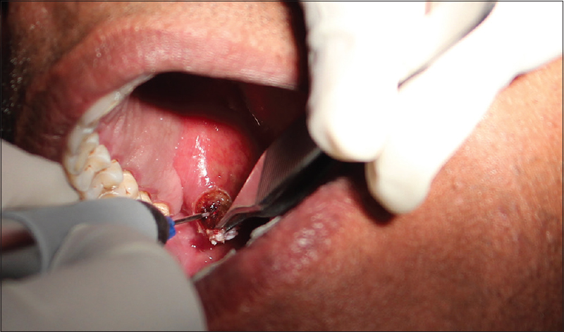
Laser excision

Slide 17
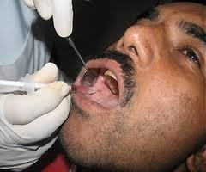
Cortisone treatment.

