Slide 1
SKIN DISEASES
Dr.Bayad J. Mahmood
Board certified maxillofacial surgeon

Slide 2
The common skin diseases are classified into:
Benign skin diseases.
Malignant skin diseases (skin cancers).

Slide 3
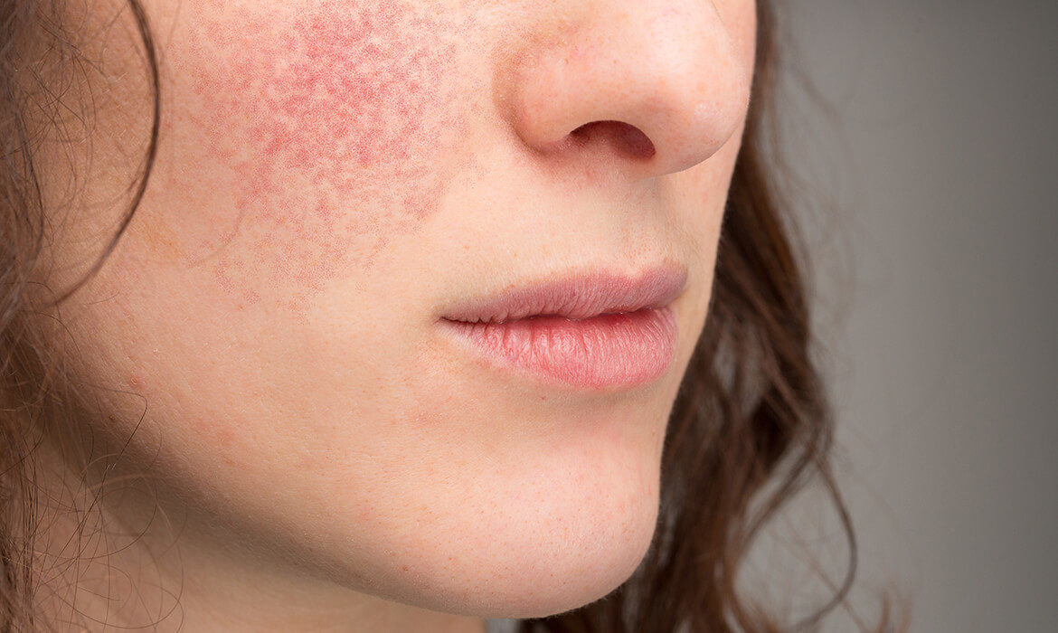
Benign skin diseases:
ECZEMA
Eczema is a term describing a range of persistent skin conditions that include dryness and recurring rashes characterized by redness, itching, crusting, flaking, blistering, cracking, oozing or bleeding.

Slide 4
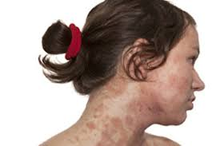
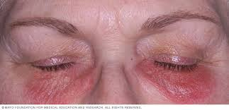
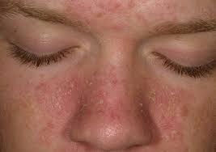
Clinical features
Common types of eczema include the following:
•Atopic eczema is believed to have a hereditary component (often runs in families whose members also have asthma and/or hay fever). It is particularly noticeable on face and scalp, neck, inside of elbows, behind knees and buttocks.
•Contact dermatitis is irritant (resulting from direct reaction to a solvent) or allergic.
•Seborrhoeic dermatitis causes dry or greasy scaling of scalp and eyebrows, scaly pimples and red patches.

Slide 5
General management
Patch-testing, raised serum immunoglobulin E (IgE), eosinophilia, radioallergosorbent test (RAST) or paper radioimmunosorbent test (PRIST) may be diagnostically helpful.
There is no known cure; treatments, which aim to control symptoms, reduce inflammation and relieve itching, include topical emollients, corticosteroids, or calcineurin inhibitors.
Ciclosporin, azathioprine or methotrexate may rarely be needed.

Slide 6
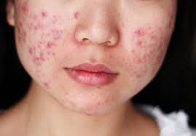
ACNE
General aspects:
Acne is a common skin disorder in which hair follicles become blocked with oil and hypertrophied epithelium, and is characterized by clogged pores and pimples.
More than four out of five people, particularly adolescent males, develop acne.
Several factors – including hormones, bacteria, medications such as corticosteroids, heredity and stress – play a role.
Many adult women experience mild to moderate acne due to hormonal changes associated with menstrual cycles, starting or stopping oral contraceptives or pregnancy.

Slide 7
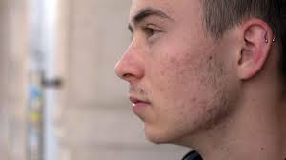
Clinical features
Pimples appear as hair follicles, become plugged with oil and dead skin cells, causing the follicle wall to bulge and produce a ‘whitehead’.
If the pore stays open and traps dirt, the plug surface oxidises and darkens, causing a ‘blackhead’.
Blockages and inflammation deep inside hair follicles can produce scarring and cysts.
Acne is rarely serious, but it often causes emotional distress.

Slide 8
General management
Effective lotions generally contain benzoyl peroxide or azelaic acid.
Topical erythromycin and clindamycin are effective treatments for inflamed lesions.
Systemic acne treatment should start with antimicrobials (tetracyclines or erythromycin).
Options for scarring cystic acne or acne that fails to respond to other treatments are, in women, cyproterone acetate or isotretinoin (vitamin A analogue, only prescriptible by consultant dermatologists). For men, only isotretinoin is available.
Dermabrasion (removing the top skin layers with a rapidly rotating wire brush) may help more severe scarring.
Laser resurfacing can achieve the same effect.

Slide 9
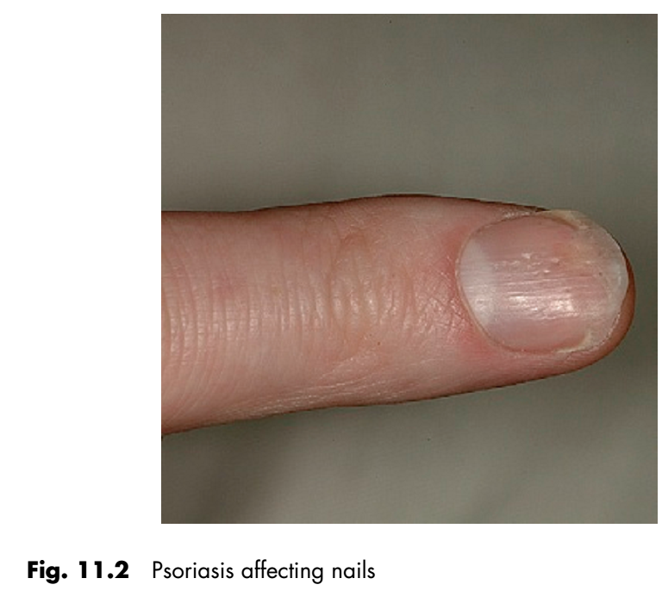
PSORIASIS
General aspects:
Psoriasis is a common chronic skin disease characterized by scaling and inflammation.
Psoriasis has a strong genetic background with HLA-Cw6 and HLA-DR7. T cells trigger inflammation, and excessive skin cell reproduction underlies the pathogenesis.
There are sometimes associations with stress and alcoholism.

Slide 10
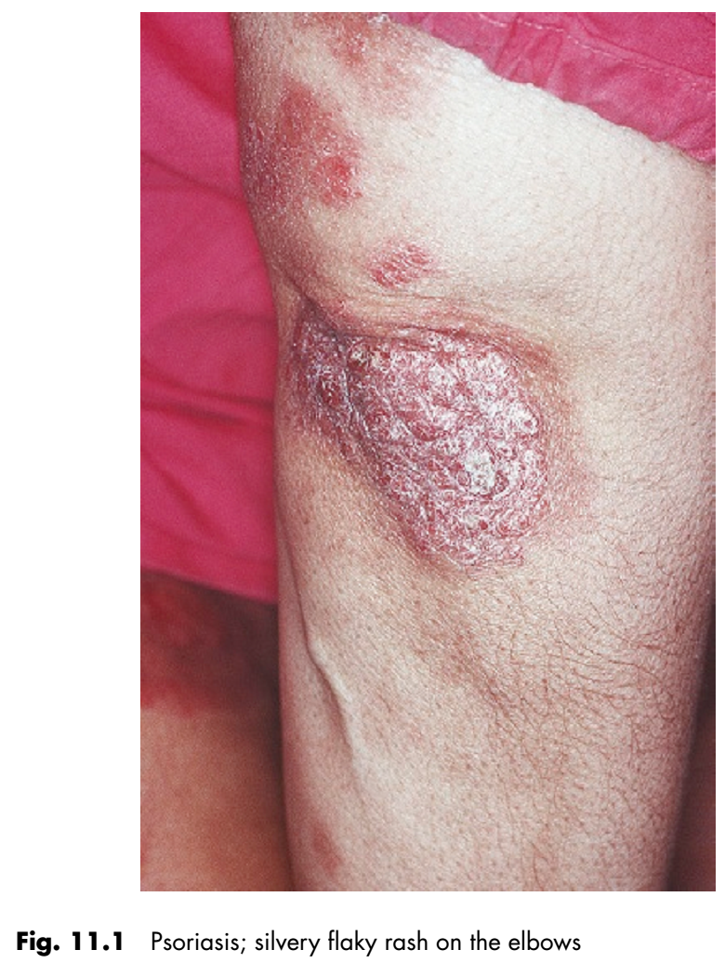
Clinical features
Psoriasis causes thick pruritic erythematous plaques covered with silvery scales predominantly on scalp, elbows and knees, lower back, face, palms, and soles of feet, and ‘ice-pick’ pitting or onycholysis of fingernails and toenails.
About 15% have joint inflammation (psoriatic arthropathy).

Slide 11
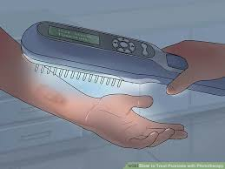
General management
Treatment of psoriasis initially is with topical agents – corticosteroids, vitamin D3, vitamin A analogues (retinoids), coal tar or anthralin. Failing this, light (phototherapy) is used.
Sunlight often helps but more controlled artificial light treatment may be used in mild psoriasis (ultraviolet B phototherapy), or psoralen and ultraviolet A (PUVA) therapy in more severe or extensive psoriasis.
Severe cases of psoriasis may need systemic treatment with methotrexate, ciclosporin or retinoids.

Slide 12
Dental aspects
Local anaesthesia (LA) is safe. Conscious sedation can be given if required.
Oral lesions such as white or reddish mucosal plaques are rare.
There may be a higher prevalence of erythema migrans and fissured tongue, particularly in pustular psoriasis.
The temporomandibular joint is involved in up to 60% of patients with psoriatic arthropathy.
Oral complications of the treatment of psoriasis, such as gingival swelling from ciclosporin, or ulceration from methotrexate, may be seen.

Slide 13
SKIN CANCER
The three major types of skin cancer, all on the increase, are:
Basal cell carcinoma (BCC; rodent ulcer)
Squamous cell carcinoma (SCC)
Melanoma.
Nearly half of all men over 65 years will develop a skin cancer.

Slide 15
Clinical features and management
Skin cancer develops mainly on areas of sun-exposed skin: the scalp, face, lips, ears, neck, chest, arms and hands, and on the legs in women.

Slide 16
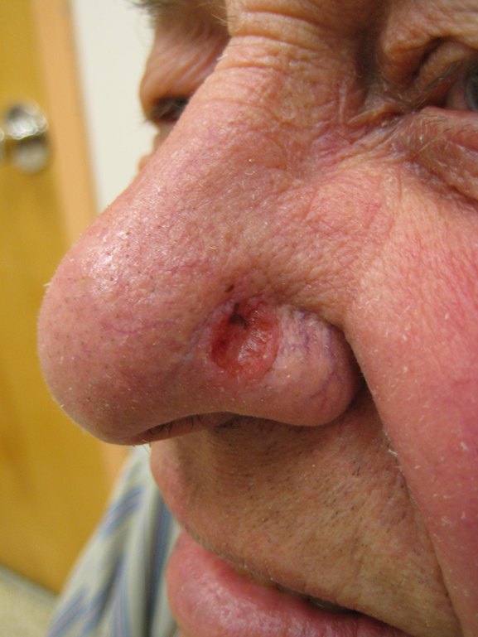
Basal cell carcinoma (BCC; rodent ulcer)
BCC is superficial and highly treatable, especially if found early. It appears as a pearly or waxy lump on the face, ears or neck or a flat, flesh-coloured or brown scar like lesion on the chest or back, typically in persons after middle age, but responds to excision with safe margin.
In Gorlin syndrome, BCC can start to form in childhood.

Slide 18
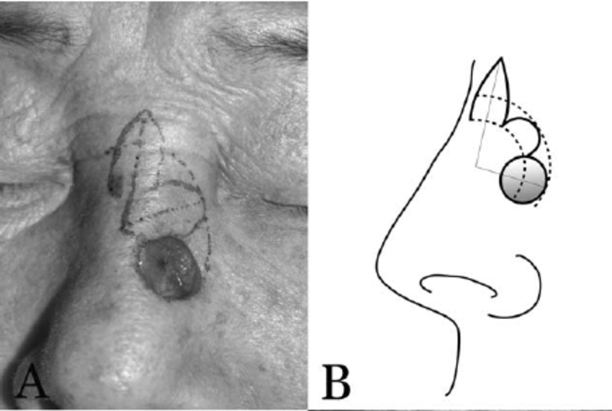

Slide 19
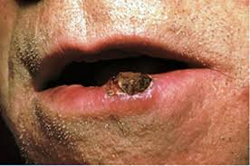
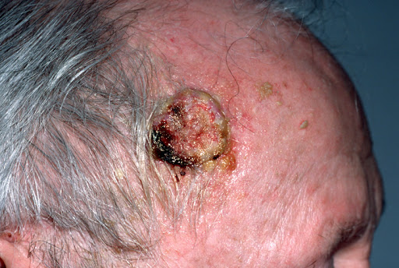
Squamous cell carcinoma (SCC)
Squamous cell carcinoma is superficial, slow or rapidly growing.
It presents as a firm, red nodule on the face, lip, ears, neck, hands or arms or a flat lesion with a scaly, crusted surface on the face, ears, neck, hands or arms.
It usually responds to wide excision with safe margin.

Slide 20
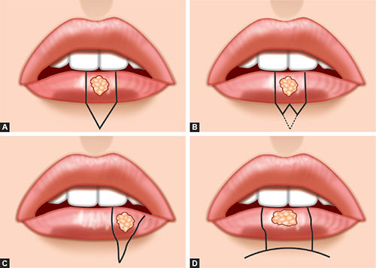
wide excision

Slide 21
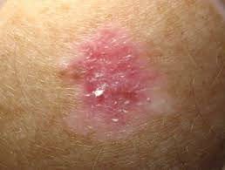
Melanoma
Melanoma has the greatest potential to spread and is potentially fatal.
It typically appears as: a large brownish spot with darker speckles, anywhere; a simple mole anywhere that changes in colour or size or consistency, or that bleeds or exhibits new growth; (amelanotic melanoma).

Slide 22
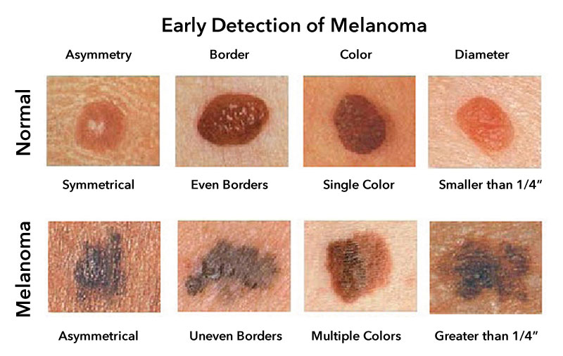

Slide 24
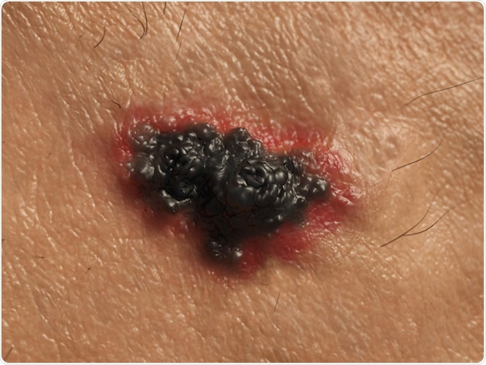
Malignant melanomas can also form in the retina or rarely, even in areas protected from sunlight such as the mouth.
Treatment of melanoma is usually excision, and if the tumour is superficial (Breslow depth < 1.5 mm) the prognosis is excellent at 90% 5-year survival.
The prognosis of malignant melanoma is usually poor as a consequence of late diagnosis and rapid spread: survival averages only 2 years.
Dental aspects Dentists are a risk group for skin cancers (from excess vocational sun exposure!).

Slide 25
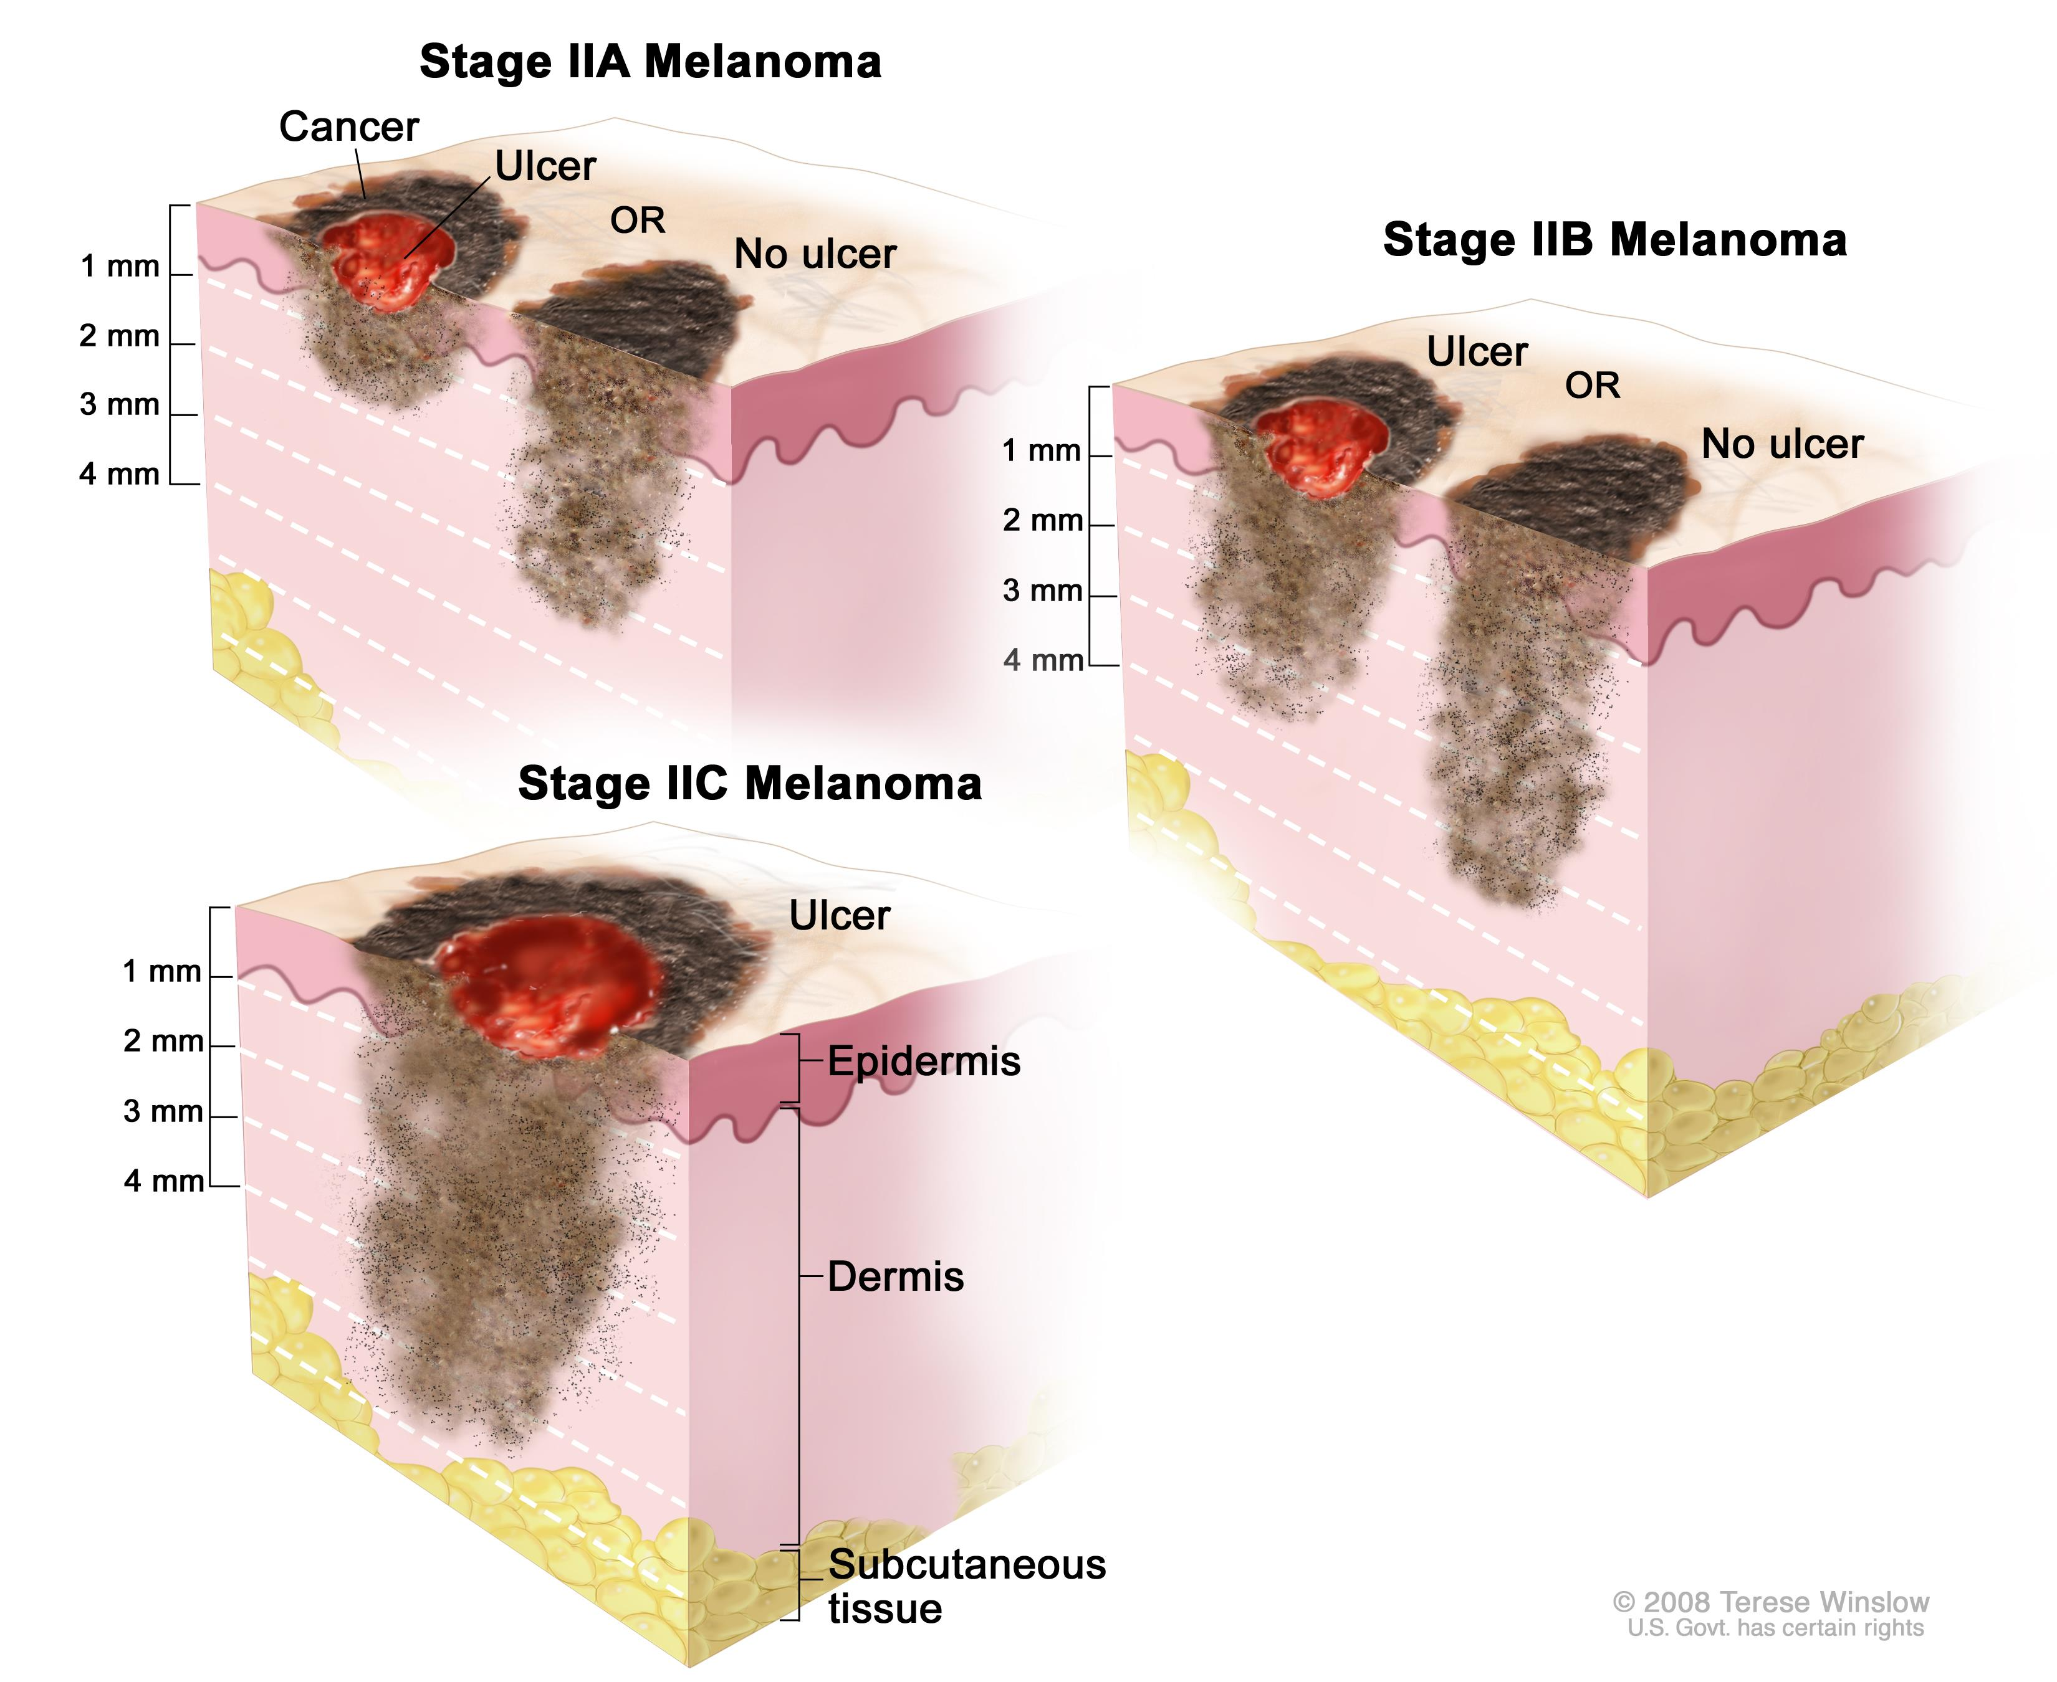

Slide 27
Thanks

