Slide 1
Surgical extrcations ( open extraction)

Slide 2
Surgical extraction; is the method by which a tooth is removed from its socket, after creating a flap and removing part of the bone that surrounds the tooth.
Surgical extraction (also called "open extraction") is a tooth removal procedure in which surgical access is required to completely remove a tooth.

Slide 3
Indications
Teeth of the maxilla or mandible that present unusual root morphology
Teeth with hypercementosis of root and root tip, presenting large bulbous roots.
􀁏 Teeth with dilaceration of root tips.
􀁏 Teeth with ankylosed roots or with abnormalities, e.g., dens in dente.
􀁏 Impacted and semi-impacted teeth

Slide 4
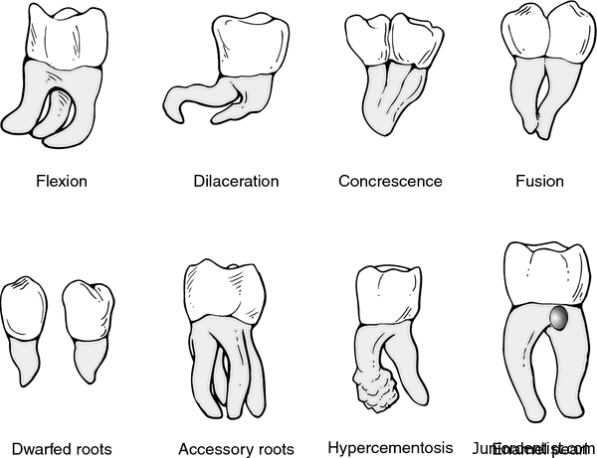

Slide 5
Teeth fused with an adjacent tooth
Broken root tips that have remained in the alveolar bone
Maxillary posterior teeth, whose roots are included in the maxillary sinus .
Roots with periapical lesions

Slide 10
Advantages of Surgical Tooth extraction
1. Increased accessibility and visiblity of the operating site. 2. Avoids unnecessary laceration of adjoining soft tissue 3. Decreased chances of breakage of tooth 4 Less postoperative complications

Slide 11
Steps of tooth extraction: 1. Creation of a flap. 2. Removal of bone and exposure of an adequate part of the root. 3. Extraction of the tooth or root with elevators or forceps. 4. Postoperative care of wound and suturing

Slide 21
Good Luck

